Slide 1
Xamarin.Android
Binding native libraries

Slide 2
Xamarin.iOS: Binding native libraries
Robert Hedgpeth
Mobile Architect, Xamarin
Senior Software Engineer, Microsoft
@robhedgpeth
https://github.com/rhedgpeth/
rob@hedgpethconsulting.com
http://www.hedgpethconsulting.com
Notes:
This is a Client Services’ Coding Best Practices presentation on
General memory management best practices
Using profiling to pinpoint and eliminate performance issues with apps
A look at performance best practices and common pitfalls for Xamarin.iOS, Xamarin.Android, and Xamarin.Forms

Slide 3





































TITANIUM SPONSORS
Platinum Sponsors
Gold Sponsors

Slide 4
What is Xamarin?
Xamarin is a cross-platform implementations of the Common Language Infrastructure (CLI) and Common Language Specifications (often called Microsoft .NET).
With a C#-shared code base, developers can use Xamarin tools to write native Android, iOS, and Windows apps with native user interfaces and share code across multiple platforms.
Notes:
This is a Client Services’ Coding Best Practices presentation on
General memory management best practices
Using profiling to pinpoint and eliminate performance issues with apps
A look at performance best practices and common pitfalls for Xamarin.iOS, Xamarin.Android, and Xamarin.Forms

Slide 5
What is Xamarin?
Notes:
This is a Client Services’ Coding Best Practices presentation on
General memory management best practices
Using profiling to pinpoint and eliminate performance issues with apps
A look at performance best practices and common pitfalls for Xamarin.iOS, Xamarin.Android, and Xamarin.Forms

Slide 6
What is Xamarin.Android?
C# is compiled to Intermediate Language (IL) and packaged with Mono Virtual Machine + Just In Time (JIT).
When the app launches, all the DLLs are loaded into the Mono Runtime, JIT compiled, and the app is started.
Unused classes in the framework are stripped out during linking.
The application runs side-by-side with Java/ART (Android runtime) and interacts with the native types via Java Native Interface (JNI).
Notes:
Notes on the AOT process here

Slide 7
What is Xamarin.Android?
Notes:
TODO: Use better image here, and use this image farther down

Slide 8
Why use Xamarin.Android?
Written in a common language; C#
Potentially large amount of code sharing through the use of .NET features such as shared projects and Portable Class Libraries (PCL’s)
Nuget packages
Components store
Enhanced testing integration
Notes:
This is a Client Services’ Coding Best Practices presentation on
General memory management best practices
Using profiling to pinpoint and eliminate performance issues with apps
A look at performance best practices and common pitfalls for Xamarin.iOS, Xamarin.Android, and Xamarin.Forms

Slide 9
Packages and Components
Xamarin Components provide a variety of different components to use in Xamarin.iOS and Xamarin.Android applications. Components range from user interface controls to code libraries, as well as user interface themes. They allow applications built on Xamarin to create rich user experiences and integrate with many different third party services with very little work.
Nuget Packages
Notes:
This is a Client Services’ Coding Best Practices presentation on
General memory management best practices
Using profiling to pinpoint and eliminate performance issues with apps
A look at performance best practices and common pitfalls for Xamarin.iOS, Xamarin.Android, and Xamarin.Forms

Slide 10
Components/packages vs native options
400+ components
Hundreds of Android accessible Nuget packages
Thousands of native libraries
Notes:
TODO: Replace with a different “I want that.” type meme.

Slide 11
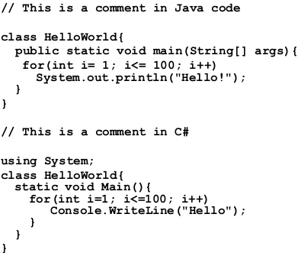
So, what can be done?
Option 1: Porting the code
Small amount code
Highly flexible

Slide 12
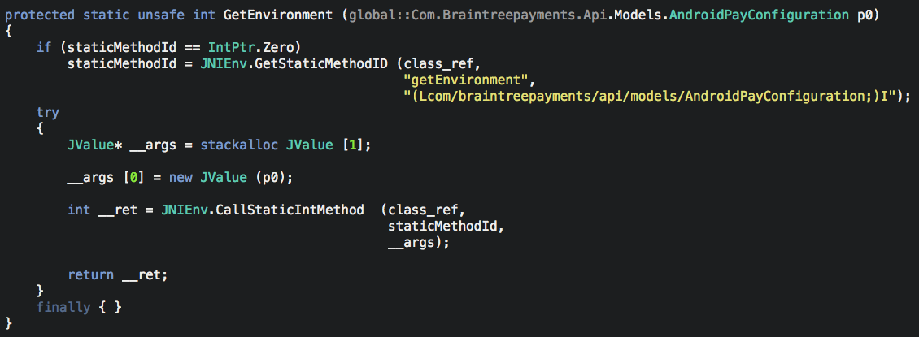
Option #2: Use JNI directly
The Java Native Interface (JNI) is a framework that allows non-Java code (such as C++ or C#) to call or be called by Java code running inside a Java Virtual Machine (JVM).

Slide 13
Option #3: Xamarin.Android Bindings
Xamarin Binding Projects can be used to create a C# binding (translation) to native Java libraries.
What can binding projects bind to?
.JAR files
.AAR files
Eclipse projects*

Slide 14
What is Java Library Binding?
Allows instance creation, method invocation, field access, inheritance, method overriding, etc.
Automagically generates properties and events for some Java constructs
get/set method pairs converted to properties
Java listeners into events
Follows .NET conventions: interfaces start with “I”, PascalCased over camelCasing, etc.

Slide 15
JARs
JAR (Java Archive) is a package file format typically used to aggregate many Java class files and associated metadata and resources (text, images, etc.) into one file to distribute application software or libraries on the Java platform.
A .java file contains your Java source code while a .class file contains the Java bytecode produced by the Java compiler. It is your .class files that run on the JVM to execute a Java application.
Notes:
TODO: LOOK UP MORE INFO ON THE IMAGE

Slide 16
AAR
The .AAR (Android Archive) file is the file format for Android libraries. An .AAR file is a .ZIP archive that contains the following:
Compiled Java code
Resource IDs
Resources
Meta-data (i.e. Activity declarations, permissions)
Notes:
This is a Client Services’ Coding Best Practices presentation on
General memory management best practices
Using profiling to pinpoint and eliminate performance issues with apps
A look at performance best practices and common pitfalls for Xamarin.iOS, Xamarin.Android, and Xamarin.Forms

Slide 17
.JAR vs. .AAR
.AAR’s include resources such as layouts, drawables etc. This makes it a lot easier to create self-contained visual components. For example if you have multiple apps that use the same login screen, with Jars you could share classes but not the layout, styles, etc., you still had to duplicate them. With AARs everything is bundled in one package.
Notes:
This is a Client Services’ Coding Best Practices presentation on
General memory management best practices
Using profiling to pinpoint and eliminate performance issues with apps
A look at performance best practices and common pitfalls for Xamarin.iOS, Xamarin.Android, and Xamarin.Forms

Slide 18
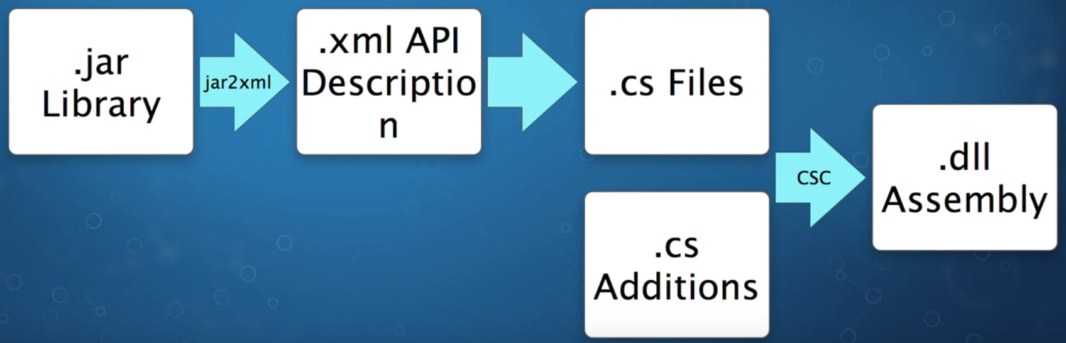
Xamarin.Android Binding Process

Slide 19
Xamarin.Android Binding Process

Slide 20
Managed Callable Wrappers
Managed callable wrappers (MCW) code uses Java Native Interface (JNI) to forward your API calls to the underlying java file.
MCW’s encapsulate JNI use so that the client code does not need to know about the underlying complexity.
JNI is a programming framework that enables Java code running in a Java Virtual Machine (JVM) to call and be called by native applications.
*Note that the JNI can be used without binding projects (manually) as well.
Notes:
This is a Client Services’ Coding Best Practices presentation on
General memory management best practices
Using profiling to pinpoint and eliminate performance issues with apps
A look at performance best practices and common pitfalls for Xamarin.iOS, Xamarin.Android, and Xamarin.Forms

Slide 21
Using JARs/AARs in a Xamarin.Android app
Xamarin tooling can generate a Bindings Library from one or more input .JAR/.AAR files. The Bindings Library (which compiles down to a .DLL assembly) contains the following:
The contents of the original .JAR/.AAR file(s).
Managed Callable Wrappers, which are C# types that wrap corresponding Java types within the .JAR/.AAR file(s).
Notes:
This is a Client Services’ Coding Best Practices presentation on
General memory management best practices
Using profiling to pinpoint and eliminate performance issues with apps
A look at performance best practices and common pitfalls for Xamarin.iOS, Xamarin.Android, and Xamarin.Forms

Slide 22
Xamarin.Android Binding Project
Notes:
This is a Client Services’ Coding Best Practices presentation on
General memory management best practices
Using profiling to pinpoint and eliminate performance issues with apps
A look at performance best practices and common pitfalls for Xamarin.iOS, Xamarin.Android, and Xamarin.Forms

Slide 23
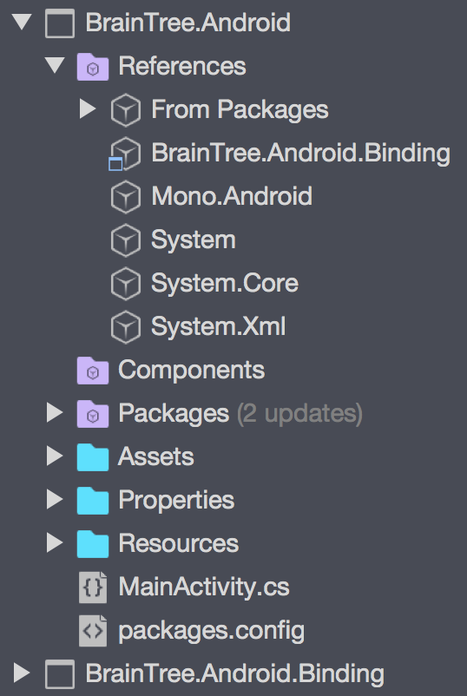
Xamarin.Android Binding Project
Reference can be added by multiple project types
The C# bindings can be accessed (with full Intellisense) just like they would be in Java
Notes:
This is a Client Services’ Coding Best Practices presentation on
General memory management best practices
Using profiling to pinpoint and eliminate performance issues with apps
A look at performance best practices and common pitfalls for Xamarin.iOS, Xamarin.Android, and Xamarin.Forms

Slide 24
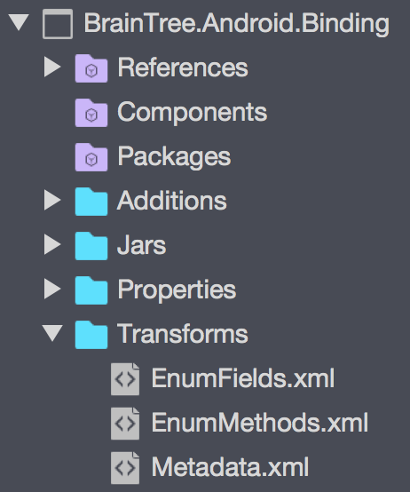
Xamarin.Android Binding Project
Additions
Jars
Transforms
EnumFields.xml
EnumMethods.xml
Metadata.xml
Notes:
This is a Client Services’ Coding Best Practices presentation on
General memory management best practices
Using profiling to pinpoint and eliminate performance issues with apps
A look at performance best practices and common pitfalls for Xamarin.iOS, Xamarin.Android, and Xamarin.Forms

Slide 25
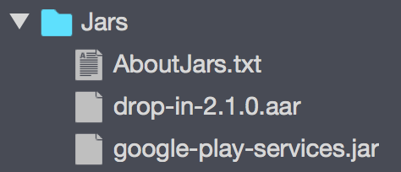
Add Jars/AARs to the binding project
The template includes a Jars folder where you add your .JAR(s) or .AAR(s) to the Bindings Library project.
Notes:
This is a Client Services’ Coding Best Practices presentation on
General memory management best practices
Using profiling to pinpoint and eliminate performance issues with apps
A look at performance best practices and common pitfalls for Xamarin.iOS, Xamarin.Android, and Xamarin.Forms

Slide 26
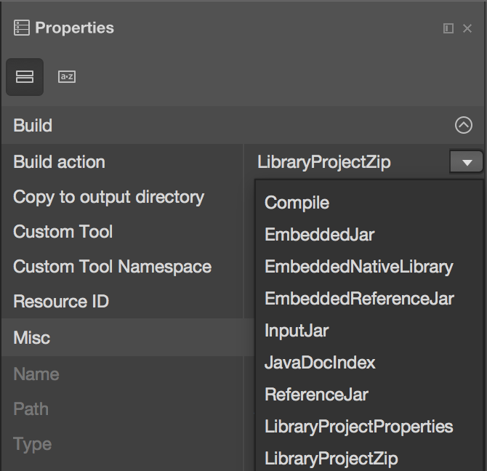
Jars and .AARs
Set the appropriate build action on the library file.
.AAR
LibraryProjectZip
.JAR
EmbeddedJar
InputJar
Notes:
LibraryProjectZip = the ZIP file build action
EmbeddedJar = included into the DLL on build
InputJar = not included into the DLL on build

Slide 27
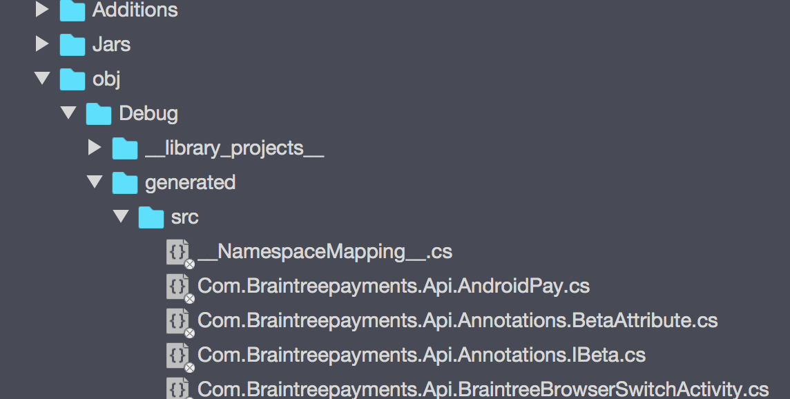
Under the hood
Notes:
This is a Client Services’ Coding Best Practices presentation on
General memory management best practices
Using profiling to pinpoint and eliminate performance issues with apps
A look at performance best practices and common pitfalls for Xamarin.iOS, Xamarin.Android, and Xamarin.Forms

Slide 28
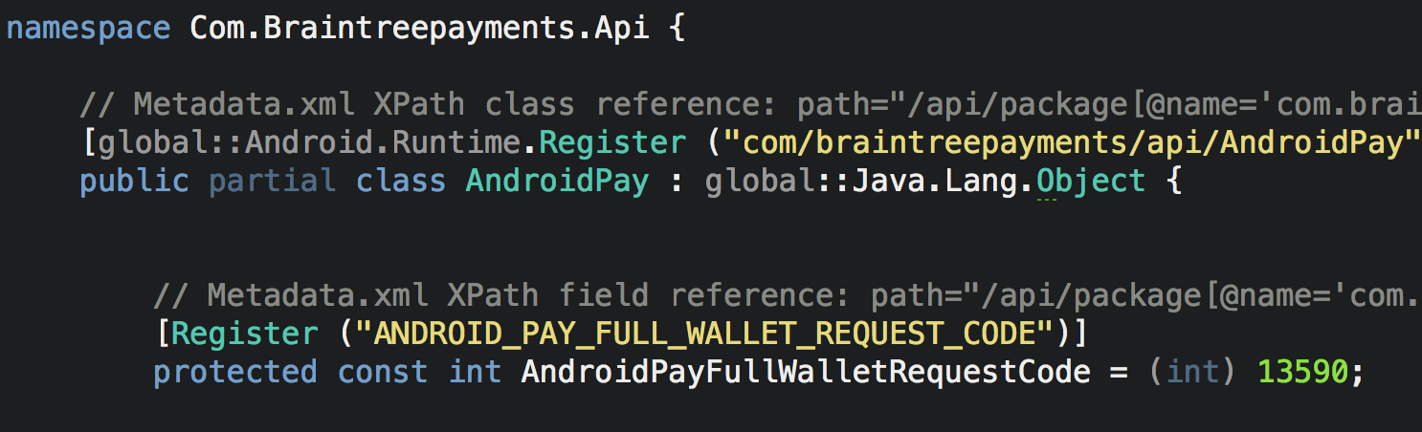
Under the hood
Notes:
This is a Client Services’ Coding Best Practices presentation on
General memory management best practices
Using profiling to pinpoint and eliminate performance issues with apps
A look at performance best practices and common pitfalls for Xamarin.iOS, Xamarin.Android, and Xamarin.Forms

Slide 29
Common Issues
Covariant return types
Accessibility
Naming collisions
Java generics
Notes:
TODO: Get descriptions on all of these

Slide 30
Metadata.xml
The Metadata.xml file allows general-purpose changes through XPath expressions to the binding such as:
Renaming namespaces, classes, methods, or fields so they follow .NET conventions.
Removing namespaces, classes, methods, or fields that aren't needed.
Moving classes to different namespaces.
Adding additional support classes to make the design of the binding follow .NET framework patterns.
Notes:
This is a Client Services’ Coding Best Practices presentation on
General memory management best practices
Using profiling to pinpoint and eliminate performance issues with apps
A look at performance best practices and common pitfalls for Xamarin.iOS, Xamarin.Android, and Xamarin.Forms

Slide 31
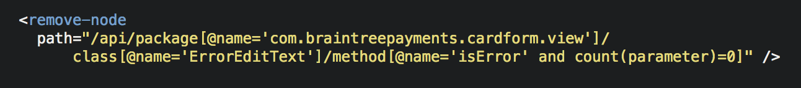
Metadata.xml examples
Transforming a Java package name to a different .NET namespace.
Removing a method.
Changing method access.
Notes:
This is a Client Services’ Coding Best Practices presentation on
General memory management best practices
Using profiling to pinpoint and eliminate performance issues with apps
A look at performance best practices and common pitfalls for Xamarin.iOS, Xamarin.Android, and Xamarin.Forms

Slide 32
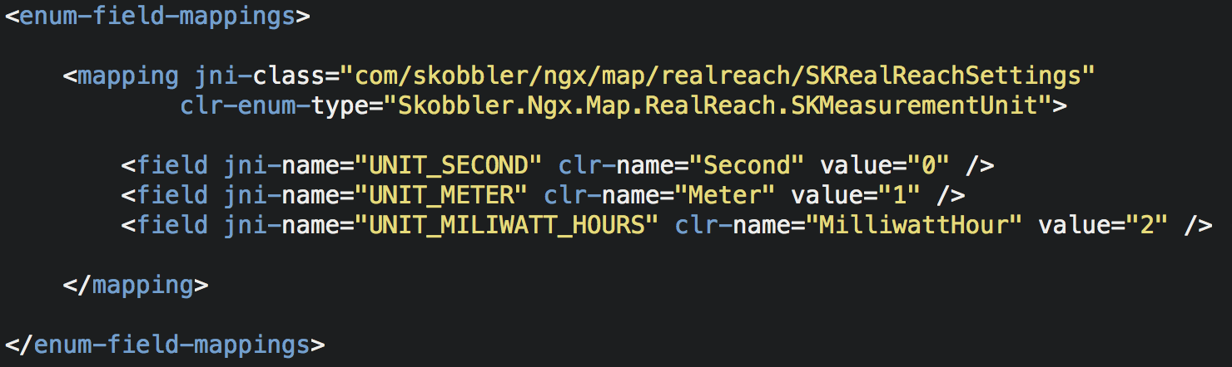
EnumFields.xml
Allows changing method parameters and return types from Java int constants to C# enums .
Notes:
This is a Client Services’ Coding Best Practices presentation on
General memory management best practices
Using profiling to pinpoint and eliminate performance issues with apps
A look at performance best practices and common pitfalls for Xamarin.iOS, Xamarin.Android, and Xamarin.Forms

Slide 33
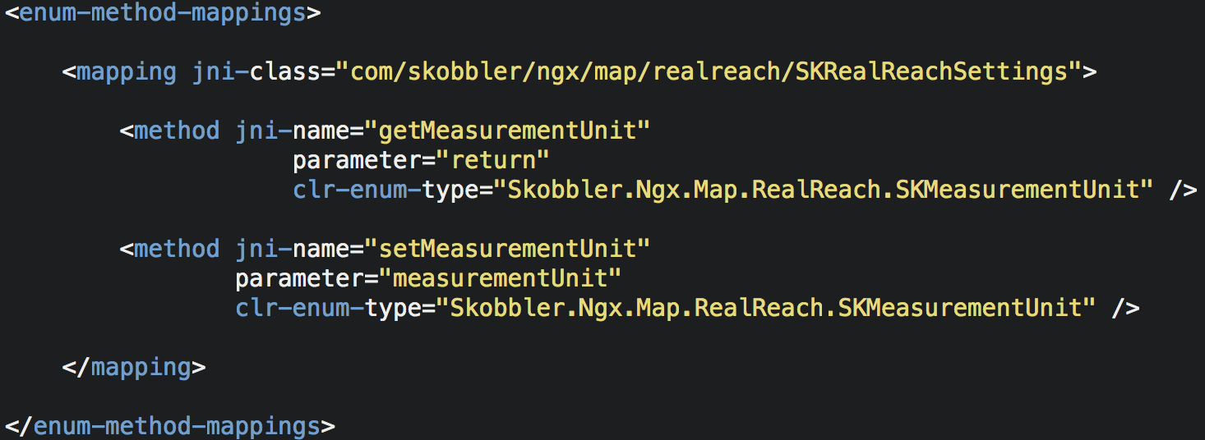
EnumMethods.xml
Allows changing method parameters and return types from Java int constants to C# enums. In other word, it maps the reading and writing of C# enums (defined in the EnumFields.xml file) to Java int constant get and set methods.
Notes:
This is a Client Services’ Coding Best Practices presentation on
General memory management best practices
Using profiling to pinpoint and eliminate performance issues with apps
A look at performance best practices and common pitfalls for Xamarin.iOS, Xamarin.Android, and Xamarin.Forms

Slide 34
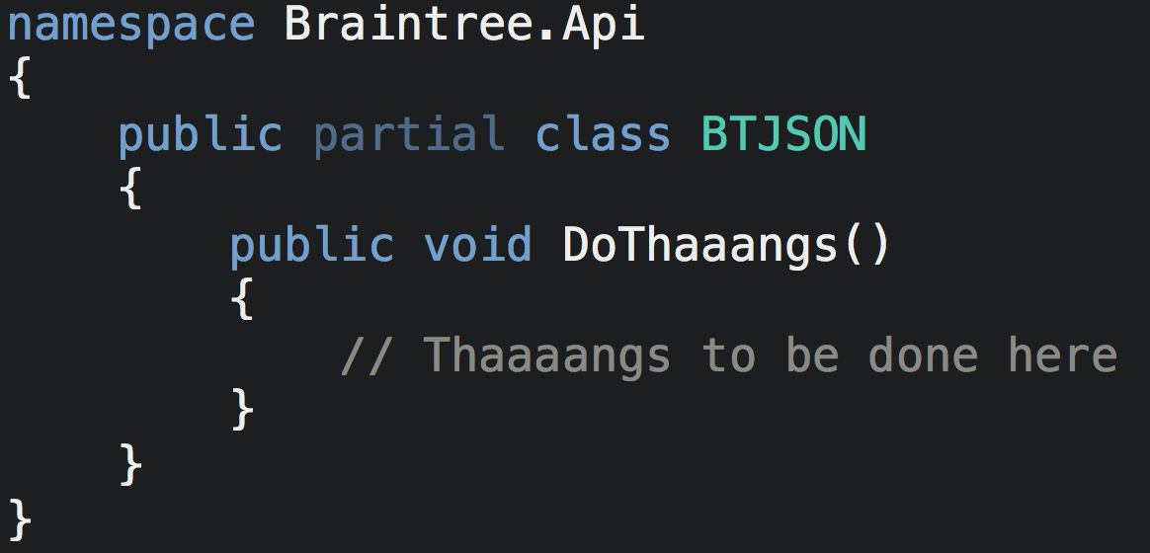
Additions
A folder which can be used to extend the (partial) classes generated by the code generator.
Notes:
This is a Client Services’ Coding Best Practices presentation on
General memory management best practices
Using profiling to pinpoint and eliminate performance issues with apps
A look at performance best practices and common pitfalls for Xamarin.iOS, Xamarin.Android, and Xamarin.Forms

Slide 35
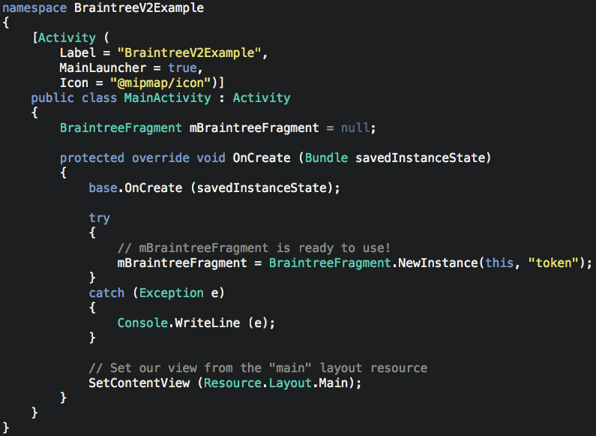
Using the binding project
Notes:
This is a Client Services’ Coding Best Practices presentation on
General memory management best practices
Using profiling to pinpoint and eliminate performance issues with apps
A look at performance best practices and common pitfalls for Xamarin.iOS, Xamarin.Android, and Xamarin.Forms

Slide 36
The code
https://github.com/rhedgpeth/BrainTree-Xamarin.Android-Binding

Slide 37
Resources
Xamarin documentation
Various (Github) examples
Me!
rob@hedgpethconsulting.com
@robhedgpeth
Notes:
This is a Client Services’ Coding Best Practices presentation on
General memory management best practices
Using profiling to pinpoint and eliminate performance issues with apps
A look at performance best practices and common pitfalls for Xamarin.iOS, Xamarin.Android, and Xamarin.Forms

